Slide 1
MINI PROJECT

Slide 2
QUESTION
DISPLAY COMMAND LOCATION GIVEN THE COMMAND NAME AS INPUT (HINT: TAKE INPUT AND DISPLAY USING WHEREIS COMMAND)

Slide 3
pyQT5
PyQt5 is one of the most popular Python bindings for the Qt cross-platform C++ framework. PyQt developed by Riverbank Computing Limited. Qt itself is developed as part of the Qt Project. PyQt5 which will build against 5.x.pyQT5 can be built for Python 2 and 3. PyQt5 contains over 620 classes that cover graphical user interfaces, XML handling, network communication, SQL databases, Web browsing and other technologies available in Qt.PyQt5 runs on Windows, Linux, Mac OS X and various UNIX platforms ,Android and iOS. Qt is set of cross-platform C++ libraries that implement high-level APIs for accessing many aspects of modern desktop and mobile systems.

Slide 4
These include location and positioning services, multimedia, NFC and Bluetooth connectivity, a Chromium based web browser, as well as traditional UI development.
PyQt5 is a comprehensive set of Python bindings for Qt v5. It is implemented as more than 35 extension modules and enables Python to be used as an alternative application development language to C++ on all supported platforms including iOS and Android.
PyQt5 may also be embedded in C++ based applications to allow users of those applications to configure or enhance the functionality of those applications.

Slide 5
CODE
from PyQt5.QtCore import *
from PyQt5.QtWidgets import *
import os
import subprocess
class Page(QDialog):
def __init__(self, parent=None): # __init__
super(Page, self).__init__(parent) # __init__
self.my_label = QLineEdit("ls")
button = QPushButton("Show Greetings")
self.outputLabel = QLabel()
self.layout = QVBoxLayout()
self.layout.addWidget(self.my_label)
self.layout.addWidget(button)
self.setLayout(self.layout)

Slide 6
self.setLayout(self.layout)
self.setWindowTitle("my first Qt app")
button.clicked.connect(self.findCommand)
def findCommand(self):
print(self.my_label.text())
# p = subprocess.Popen(["whereis",self.my_label.text()], stdout=subprocess.PIPE)
directory_content = "string"
os.system('whereis ls')
length = len(directory_content)
outputText = str(directory_content[0:length-1])
self.outputLabel.setText(outputText )
self.layout.addWidget(self.outputLabel)
if __name__ == '__main__':
import sys
app = QApplication(sys.argv)
window = Page()
window.show()
sys.exit(app.exec_())

Slide 7
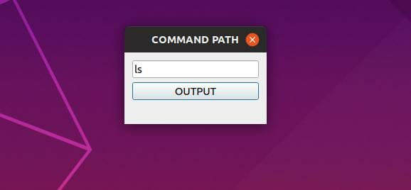
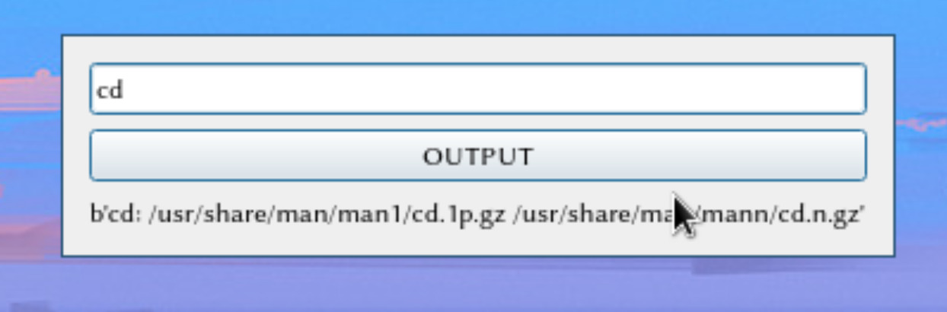
OUTPUT

Slide 8
TEAM MEMBERS
HARIKRISHNAN M
HARISHANKAR A
HONEY MARIAM BABU
IBNUL FARDEEN

Slide 9
THANK
YOU

